Slide 1
Creating Advance jQuery Mobile Pages

Slide 2
Objectives
In this session, you will learn to:
  Work with listviews
  Implement touch and scroll events

Slide 3
Working with Listviews
A listview refers to a container that contains a list of items.
You can use a listview with one or more ordered and unordered list items.
You can also add a search box to a listview to search list items.
To organize list items in a listview, you can add dividers to the listview.

Slide 4
Creating Listviews
To create a listview, you need to set the value of the data-role attribute of the <ul> or <ol> element as listview.
When you add a listview in a jQuery Mobile Web application, jQuery Mobile enriches the appearance of the listview so that all the list items fill the full width of the device screen.
The following code snippet shows how to create a basic listview:
  .
<div id="mypage" data-role="page">
<div id="content" data-role="main"
class="ui-content">
<h3>Select a Product:</h3>
<ul data-role="listview">
<li><a href="ledtv.html">LED TV</a></li>
<li><a href="mobile.html">Mobile</a></li>
<li><a href="laptop.html">Laptop</a></li>
<li><a href="desktop.html">Desktop</a></li>
</ul>
</div>
</div>

Slide 5
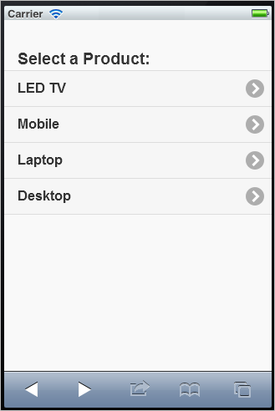
Creating Listviews (Contd.)
The following figure shows a listview in a jQuery Mobile page.

Slide 6
Formatting a Listview
To allow a user to search relevant list items from the list, you can use a search filter in a listview by:
  Adding a search field using the <input> element containing the
  data-type="search" attribute on the Web page.
  Setting the value of the data-filter attribute of the <ol> or <ul> element as true.
  Adding the data-input attribute to the <ol> or <ul> element.

Slide 7
Formatting a Listview (Contd.)
The following code snippet shows how to implement a search filter in a listview:
<form id="productform" action="productform.aspx" method="post"
class="ui-filterable">
<input id="listfilter" data-type="search">
<ol data-role="listview" data-filter="true"
data-input="#listfilter" data-inset="true">
<li><a href="#">Smart Phone</a></li>
<li><a href="#">Desktop Computer</a></li>
<li><a href="#">Laptop</a></li>
<li><a href="#">Printer</a></li>
<li><a href="#">Tablet Phone</a></li>
<li><a href="#">SLR Camera</a></li>
<li><a href="#">DSLR Camera</a></li>
<li><a href="#">DVD Player</a></li>
<li><a href="#">LED TV</a></li>
</ol>
<input type="submit" value="Submit" data-inline="true">
</form>

Slide 8
Formatting a Listview (Contd.)
To create a collapsible listview, you need to set the values of the data-role attribute as collapsible and the data-collapsed attribute as true in the container element (such as a <div> element) that contains the listview.
The following code snippet shows how to create a collapsible listview:
<div data-role="collapsible" data-collapsed="true">
<h2>Books and Media:</h2>
<ul data-role="listview" data-inset="true">
<li><a href="#">Academic & Professional</a></li>
<li><a href="#">Business & Management</a></li>
<li><a href="#">Literature & Fiction</a></li>
<li><a href="#">Entrance Exam</a></li>
<li><a href="#">Comics</a></li>
</ul>
</div>

Slide 9
Formatting a Listview (Contd.)
To group list items of a listview into categories or sections, add the
data-role="list-divider" attribute in the <li> element, used to define categories of a list item.
The following code snippet shows how to use dividers in a listview to alphabetically arrange list items:
<ul data-role="listview" data-inset="true">
<li data-role="list-divider">Electronics: </li>
<li><a href="#">Smart Phone</a></li>
<li><a href="#">Desktop Computer</a></li>
<li data-role="list-divider"> Books and Media:</li>
<li><a href="#">Academic & Professional</a></li>
<li><a href="#">Business & Management</a></li>
<li data-role="list-divider">Home and Kitchen:</li>
<li><a href="#">Kitchen Appliances</a></li>
<li><a href="#">Home Appliances</a></li>
</ul>

Slide 10
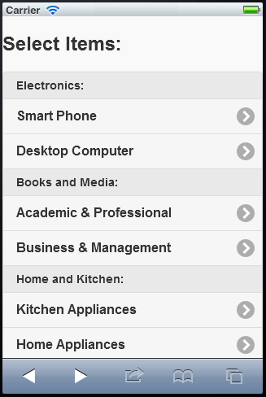
Formatting a Listview (Contd.)
The output of the preceding code snippet is shown in the following figure.

Slide 11
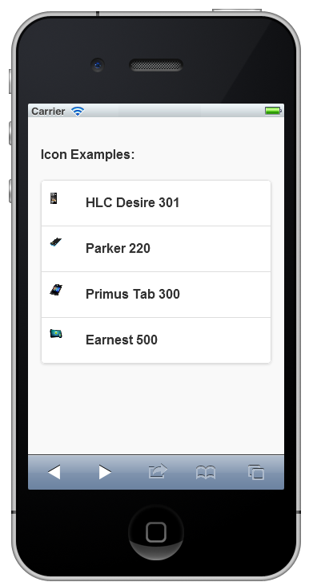
Adding Icons and Thumbnail Images in a Listview
To add icons, use the ul-li-icon class in the <li> elements of a listview.
The following code snippet shows how to add different icons in a jQuery Mobile page:
The following figure shows icons in list items of a listview.
<img src='Images/smartphone1.jpg' alt='HLC Desire 301 Smart Phone' class='ui-li-icon' />

Slide 12
Adding Icons and Thumbnail Images in a Listview (Contd.)
To add a thumbnail image, you need to add the <img> element within the <li> element that represents the list item.
In the <img> element, you need to use the src attribute with a value that points to the location of the thumbnail image file, as shown in the following code snippet:
<li> <img src='Images/smartphone1.jpg/>

Slide 13
Using Themes in a Listview
You can use themes in a listview in a manner similar to using themes in jQuery Mobile page elements.
Listview also supports theme inheritance.
The following code snippet shows how to apply themes in a listview:
<ul data-role="listview" data-inset='true' data-theme="b">
<li> <img src='Images/smartphone1.jpg'/>
<h3 style='margin-left: 15px'>HLC Desire 301</h3>
</li>
<li data-theme="a"> <img src='Images/smartphone2.jpg'/>
<h3 style='margin-left: 15px'>Parker 220</h3>
</li>
<li> <img src='Images/tabletphone1.jpg'/>
<h3 style='margin-left: 15px'>Primus Tab 300</h3>
</li>
</ul>

Slide 14
Adding Form Elements to a Listview
A listview can also contain a form with different form elements, such as text fields, text areas, sliders, and buttons.
To add a form to a listview:
  Add the listview within a <form> element and then add the form controls as list items.
  Use the ui-field-contain class that styles labels and form controls.

Slide 15
Just a Minute
To create an ordered listview, you need to use the ___________ attribute with the <ol> element.
  data-role="listview"
  data-role="orderedlistview"

Slide 16
Just a Minute (Contd.)
Answer:
  data-role="listview"

Slide 17
Activity: Using Listviews in a jQuery Mobile Application
You and your team have implemented the basic functionalities of the PizzaBud mobile website. Your team has received feedback regarding the presentation of the application’s UI. Based on the feedback, you and your team have decided to update the UI of the application. After consultation with senior mobile Web application consultants of your company, you and your team have decided to update the home page of PizzaBud to display the veg and non-veg pizza categories in a listview instead of hyperlinks. Your team has also decided to create separate pages for the veg and non-veg pizza categories to list pizza items in collapsible listviews alphabetically. In addition, you have decided to update the registration page to include the registration form in a listview.
Prerequisite: To perform this activity, you need the PizzaBud.zip file.

Slide 18
Implementing Touch and Scroll Events
Mobile applications should have the ability to respond to events that are generated by actions performed by a user.
For example, when a user taps a control on the device screen, the application should respond based on the application requirement.
Similarly, the application should also respond to other events such as when a user swipes on the device screen or scrolls through the content of the application vertically.

Slide 19
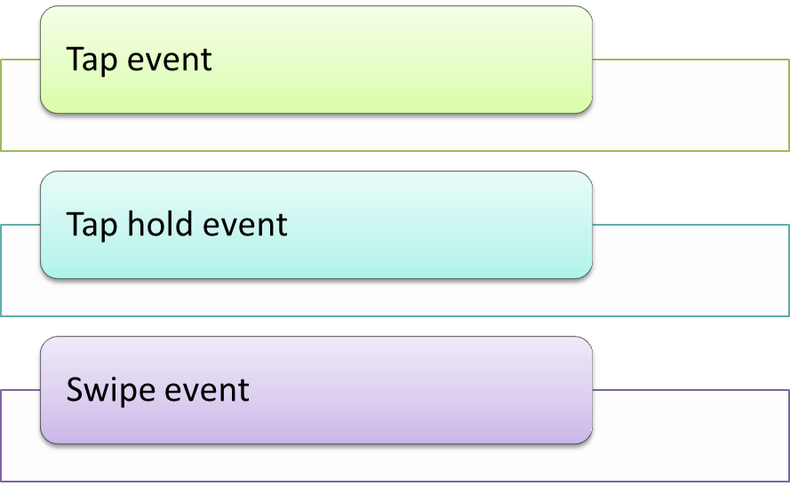
Using Touch Events
When a user touches the screen of an application on a mobile device, a touch event occurs.
In a jQuery mobile application, you can handle the following touch events:

Slide 20
Using Touch Events (Contd.)
A jQuery Mobile tap event gets triggered when a user taps some content or control on the device screen.
To handle a tap event, you need to create an event handler for the tap event.
The following code snippet implements a tap event to enlarge the content of a <div> element and display it in a different font color:
<style>
div.tapBox {
font-size: small;
color: #f00; }
div.tapBox.tap {
font-size: x-large;
color: #0094ff;
}</style>
<script>
$(function(){
$("div.tapBox").bind("tap", tapHandler);
function tapHandler( event ){
$(event.target).addClass("tap");
} }); </script>

Slide 21
Using Touch Events (Contd.)
A taphold event is triggered when a user taps and holds some content or control on the device screen.
The following code snippet implements a taphold event to enlarge the content of a <div> element and display it in a different font color:
div.tapHoldBox {
font-size: small; color: #f00; }
div.tapHoldBox.taphold {
font-size: x-large; color: #0094ff; }

Slide 22
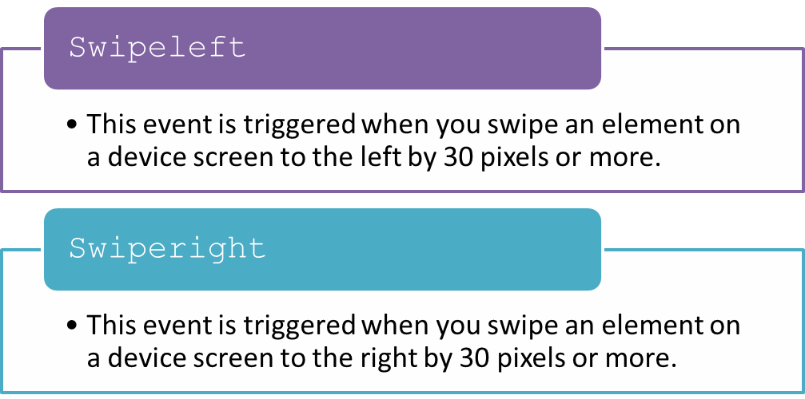
Using Touch Events (Contd.)
Mobile Web applications allow users to swipe the device screen for some interaction.
The two key swipe events that jQuery Mobile provides are:

Slide 23
Using Touch Events (Contd.)
The following code snippet implements the swiperight and swipeleft events:
<script>
$(document).on("pageinit", function(event) {
$("p").on("swiperight",function(){
$("#div1").html("You have swiped in the right direction.");
});
$("div").on("swipeleft",function(){
$("#div2").html("You have swiped in the left direction.");
});
}); </script> </head>
<body>
<div data-role="page" id="main">
<div data-role="main" class="ui-content">
<p>Swipe in the right direction.</p>
</div>
<div id="div1"></div>
<br></br>
<div data-role="main" class="ui-content">
Swipe in the left direction.</div>
<div id="div2"></div> </div>
</body>

Slide 24
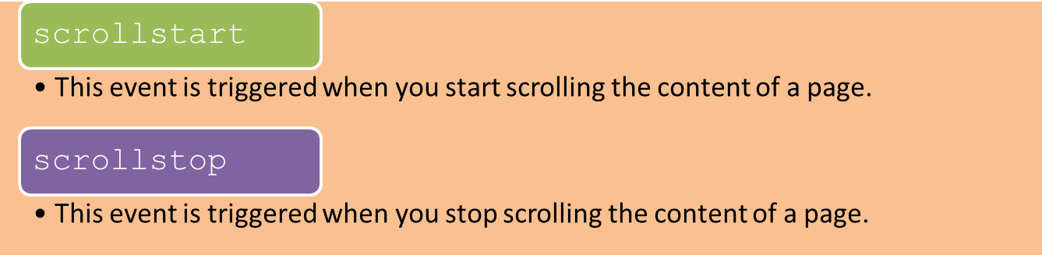
Using Scroll Events
jQuery Mobile provides the following scroll events:
The following code snippet implements the scrollstart and scrollstop events:
<script>
$(document).on("pageinit", function(event) {
$(document).on("scrollstart",function(){
$("h1").html("Scrolling started.");
});
$(document).on("scrollstop",function(){
$("h1").html("Scrolling stopped.");}); });
</script>

Slide 25
Just a Minute
The tap event is equivalent to the ________ event on a website running on desktop browsers.
  mouseover
  data-role="click"

Slide 26
Just a Minute (Contd.)
Answer:
  data-role="click"

Slide 27
Activity: Handling Touch and Scroll Events in a jQuery Mobile Application
You have submitted the PizzaBud mobile website to the client for review. The client has appreciated your effort and has provided a suggestion to enhance the look and feel and responsiveness of the application. Your client has suggested that a user should be able to swipe a pizza name in a list item to view the ingredients used in the pizza. You need to implement the swipe event in the pizza list item to address the client suggestion.
Prerequisite: To perform this activity, you need the starter PizzaBud.zip file.

Slide 28
Summary
In this session, you learned that:
  To create a listview, you need to set the value of the data-role attribute of the <ul> or <ol> element as listview.
  To create a collapsible listview, you need to set the values of the data-role attribute as collapsible and the data-collapsed attribute as true in the container element that contains the listview.
  You can use the ul-li-icon class in the <li> elements of a listview to add icons.
  You can use themes in a listview in a manner similar to using themes in jQuery Mobile page elements.
  When a user touches the screen of an application on a mobile device, a touch event occurs.
  In a jQuery Mobile application, you can handle the following touch events:
    Tap event
    Tap hold event
    Swipe event

Slide 29
What’s Next?
After this session, you need to do the following tasks:
  Read Chapter 10
  Perform the following exercises of Chapter 10:
    Exercise 1
    Exercise 2

